Slide 1

Detection of auditory brainstem response peaks
Using image processing techniques in infants
With normal hearing sensitivity
GUIDED BY:
Mr. SIVAPATHI A
PRESENTED BY:
YUVASHRI V (125003436)
PARTHASARATHY K (125003466)
HARIHARA ALAGAPPAN R (125003092)
SASTRA DEEMED TO BE UNIVERSITY, SCHOOL OF COMPUTING

Slide 2
BASE PAPER
Journal Name:
Biomedical Signal Processing and Control
Year of Publication :
2023
Publisher Name :
Elsevier
Base Paper Link :
https://www.sciencedirect.com/science/article/pii/S1746809423005505

Slide 3
Agenda for this Presentation
. Problem Statement
. Abstract
. Introduction
. Objective
. Motivation
. Pseudo code
. Methodology
. Data Set
. Work Split up
. Work Plan
. Timeline
. References

Slide 4
PROBLEM STATEMENT
To enhance accuracy and efficiency, Computer Vision techniques are employed to automate ABR waveform analysis, benefiting audiologists, especially in challenging newborn cases.

Slide 5
ABSTRACT
We developed a computer vision-based approach to automate the auditory brainstem response (ABR) test in children with normal hearing.
The method analyzes Auditory Evoked Potentials (AEPs) by automatically determining peaks of waves with varying strengths.
Using ABR test results from twenty-six children, aged one to twenty months, we proposed a novel method that achieved accuracies of 0.82, 0.98, and 0.98 for detecting waves 1, 3, and 5, respectively.
The automated process, incorporating Image Processing techniques, demonstrated a reduction in human error by 82.7% and holds promise for improving the efficiency of diagnosing hearing issues.

Slide 6
INTRODUCTION
INTRODUCTION
> A neurophysiological test evaluating the auditory pathway.
> Uses electrodes on the scalp to record neural responses.
SIGNIFICANCE
> Early detection of hearing loss, especially in newborns.-
> Provides objective assessment of auditory function.
> Helps identify type, degree, and site of hearing loss.
CHALLENGES
> Requires specialized interpretation.
> Patient cooperation issues, especially in infants.

Slide 7
OBJECTIVE
1. An approach to develop automated ABR threshold tracking tool
2. To Utilize Image Processing for wave transformation
3. To Segment waves by intensity, latency, and ear type
4. To Calculate peaks for accurate wave detection
5. To Compare results with conventional interpretation.

Slide 8
Motivation
Manual ABR test interpretation can lead to errors.
ABR tests are crucial for diagnosing hearing issues.
The goal is to create a tool for better ABR threshold tracking.
The tool will aid audiologists, especially with newborns.

Slide 9
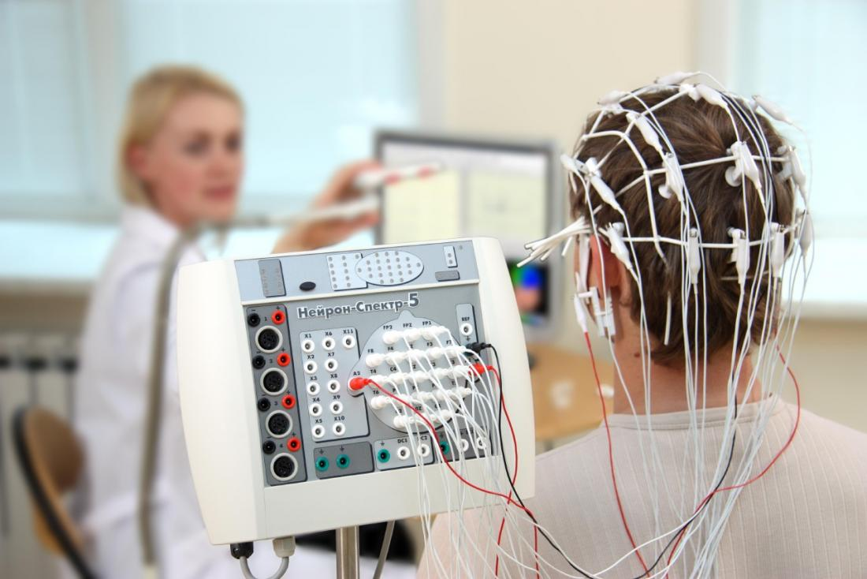
DEVICE USED DETECTING
BRAIN ACTIVITY
Electroencephalography (EEG) is a technique used to measure the electrical activity generated by the brain.
Similar to an electrocardiogram (ECG) for the heart, an EEG records the electrical activity of the brain by placing electrodes on the scalp.
EEG is often used in medical settings to diagnose conditions such as epilepsy, sleep disorders, and brain injuries, as well as in research to study brain function and cognitive processes.

Slide 10
Why Image Processing is used rather than Signal Processing ?
Data Format:
Data is image-based or closely related.
2. Visual Interpretation:
Images aid intuitive analysis and interpretation.
3. Complex Data Handling:
Images simplify analysis of complex waveform data.
4. Available Tools:
Established image processing tools are accessible.
5. Robustness and Adaptability:
Image processing techniques handle noise effectively.
6. Expertise Alignment:
Developers are skilled in image processing.
7. Advanced Infrastructure:
Infrastructure supports advanced image processing.

Slide 11
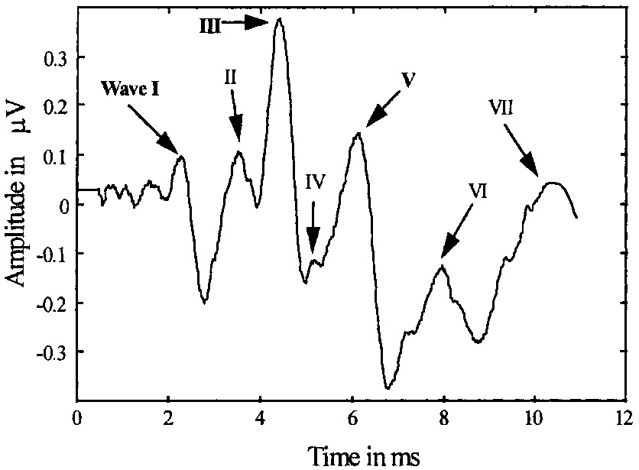
Identification of wave (1 to 7)

Slide 12
Pseudo code of proposed methods
1 Input: D: a raw dataset, img: a patient’s image which is selected from the D (left or right ear);
2 For img = 1:D
3 img = Crop img to size (2351*1951)
4 seg = Segment img to binary
w = Recall Image Region Analyzer function for extracting each wave based on Minor Axis Length (seg as input)
7 For i = 1: w
8 peak_wave = Calculate each peak of i
9 time_wave = Calculate time of peak 5 for i
10 return peak_wave, time_wave
11 End for
12 End for
13 End

Slide 13
METHODOLOGY
Acquisition of Wave Images: Wave images are acquired from an Audera device using the Color Thresholder method.
Segmentation: Each wave image is segmented into individual wave segments using the Image Region Analyzer application. This step breaks down the image into segments to simplify further processing and analysis.

Slide 14
METHODOLOGY
3.Conversion to Waves: The segmented wave images are converted into usable wave data using image processing techniques. This step involves treating each wave independently to facilitate analysis.
4.Peak Calculation: The peaks of each wave are calculated, along with their latency, to aid audiologists in diagnosing diseases. The findpeaks function is used to locate and plot significant peaks in the wave data.

Slide 15
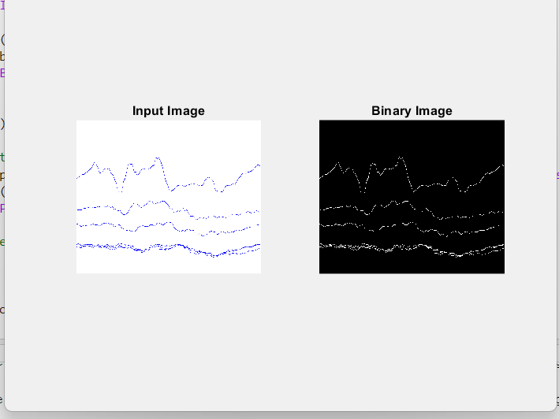
Image Preprocessing: Conversion to Binary:
Images are initially processed to convert them into binary form.
Binary conversion simplifies subsequent analysis and segmentation.
Utilizes grayscale thresholding to create binary representations.
Each pixel is categorized as foreground or background based on intensity levels.

Slide 16
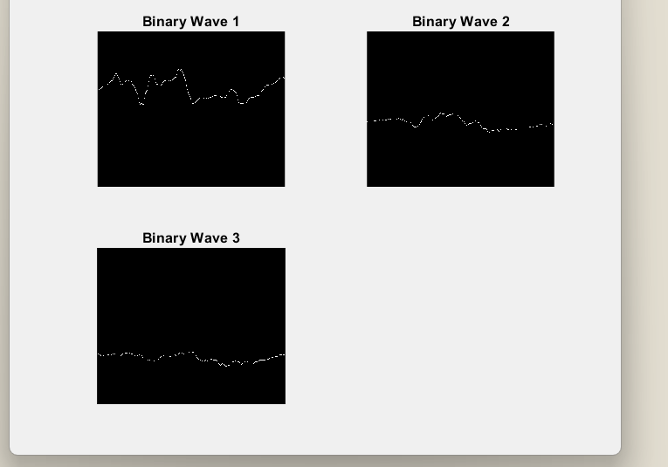
Segmentation Process:
Segmentation divides images into distinct segments for analysis.
Waves are individually segmented to isolate specific features.
Improves processing efficiency by focusing on relevant image regions.
IRA application provides detailed attributes for each segmented area.

Slide 17
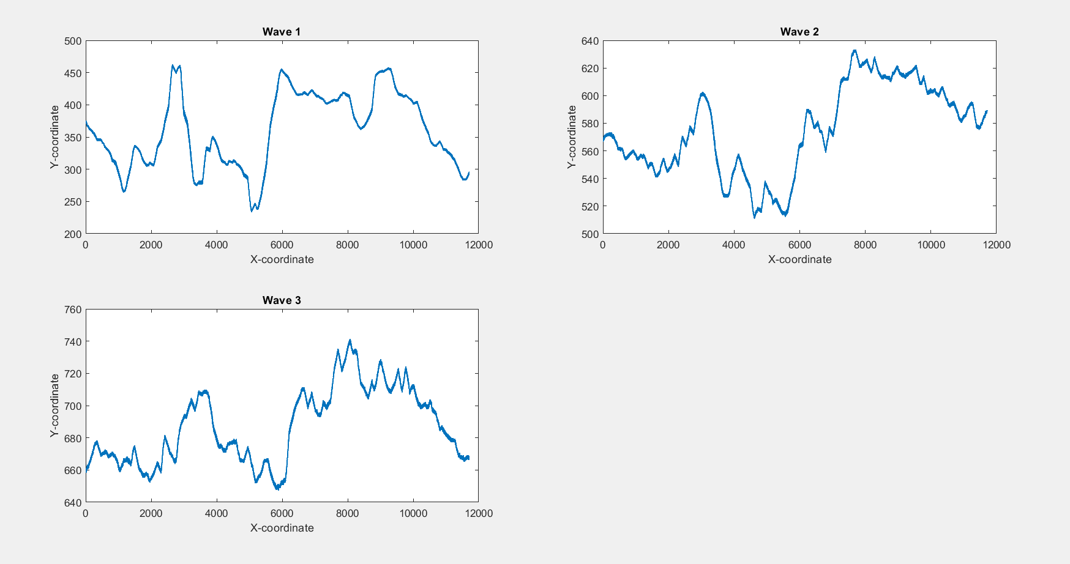
Conversion to Independent Waves:
Transforms wave images to facilitate independent analysis.
Enables isolation and analysis of individual waves.
IP capability extracts pixel data for plotting and visualization.
Enhances precision and flexibility in analyzing wave characteristics.

Slide 18
Preprocessing done to the graph before peak detection:
1. Normalization:
- The x and y coordinates of each wave (`waves_x{i}` and `waves_y{i}`) are normalized to fall within the range [0, 1].
- For the x-coordinates (`normalized_x`), each value is shifted and scaled such that the minimum value becomes 0 and the maximum value becomes 1.
- Similarly, for the y-coordinates (`normalized_y`), each value is normalized based on the minimum and maximum values within the respective wave's data range.
- Normalization ensures that all waves are plotted on a consistent scale, regardless of their original data ranges.
2. Smoothing:
- The y-coordinates (`normalized_y`) of each wave are smoothed using a moving average.
- The `smoothdata` function is used for smoothing, with the method set to `'movmean'` (moving average) and the window size specified as `10`.
- Smoothing helps reduce noise and fluctuations in the data, making it easier to identify peaks.

Slide 19
Selection of peak detection algorithm
Method 1
Paper name : Development and Evaluation of Automated Tools for
Auditory-Brainstem and Middle-Auditory Evoked Potentials
Waves Detection and Annotation
Link:
https://dspace.lib.ntua.gr/xmlui/bitstream/handle/123456789/57525/brainsci-12-01675.pdf?sequence=1&isAllowed=y

Slide 20
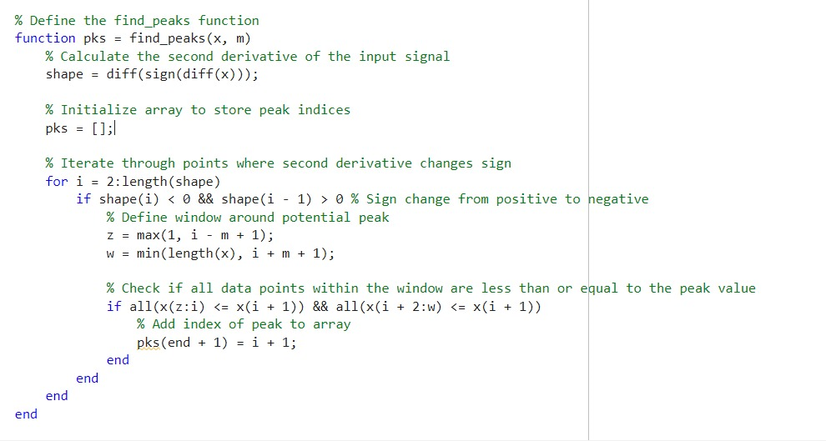
Source Code

Slide 21
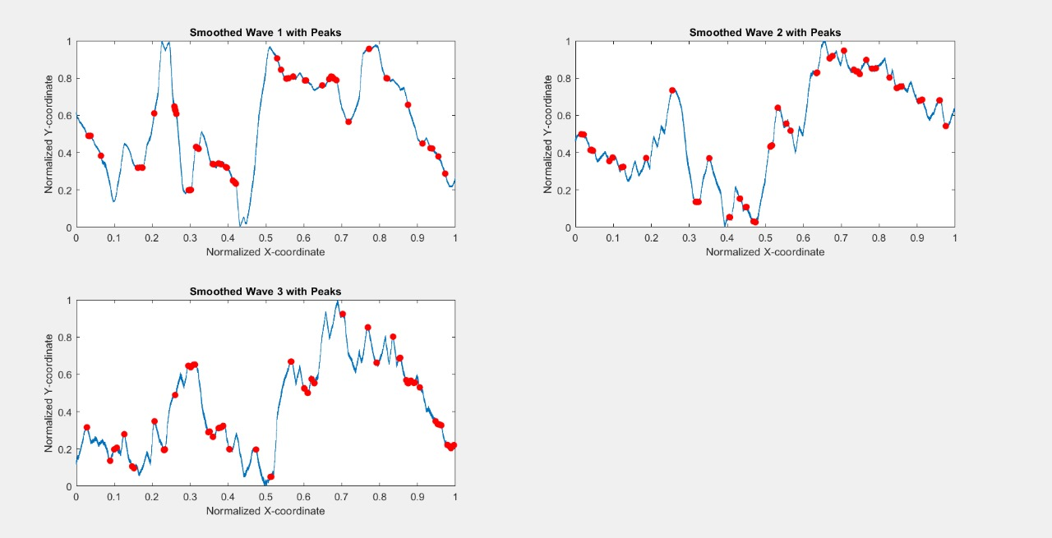
m=3

Slide 22
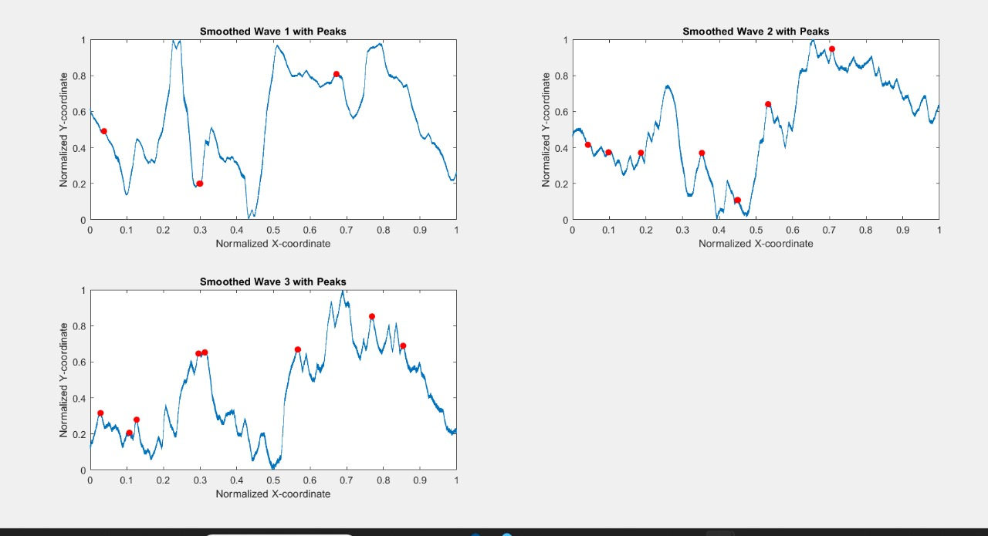
m=30

Slide 23
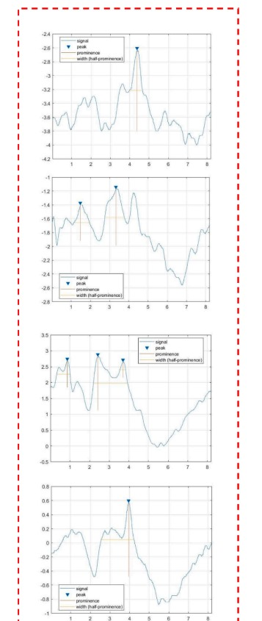
Method 2
"Selection of parameters, such as minimum peak height and minimum peak width, has been guided by the characteristics observed in the sample output images provided in the paper. Additionally, peaks that exhibit significant differences in size compared to their adjacent peaks have been identified and included in the analysis."

Slide 24
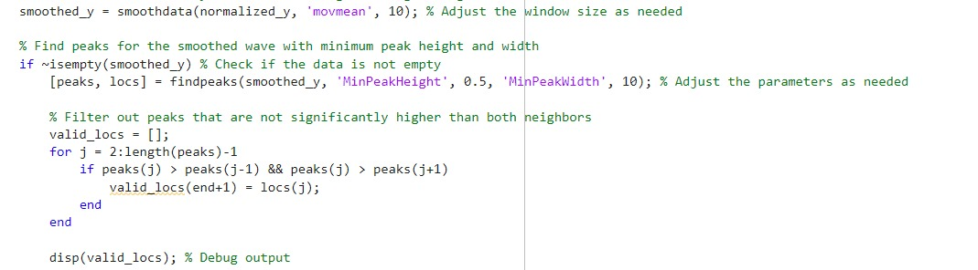

Slide 25
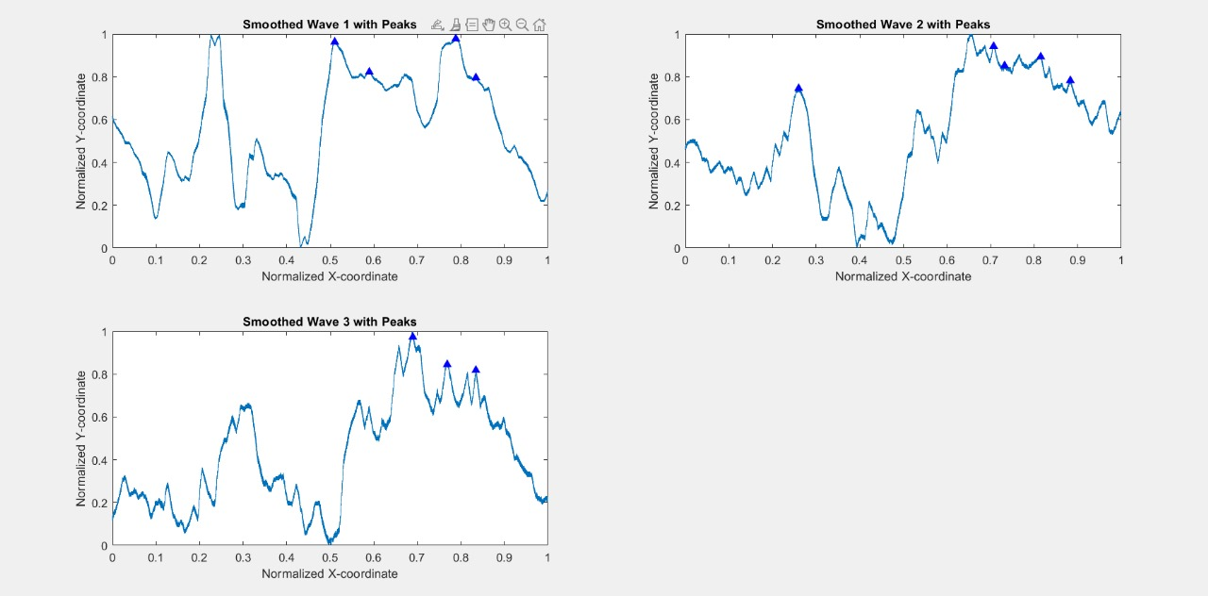
Output

Slide 26
DATASET
The audiologist's sample test reports are used as the source of our dataset. Out of the 187 image samples, 116 show normal hearing.
The sample reports include 26 newborns with ages ranging from 1 month to 20 months (average age 4.34 months, standard deviation 4.01 months
Of the 26, there are 17 female infants. All the infants included in the evaluation were of Iranian nationality, and the selection process involved individuals referred to Mofid Children's Specialized Hospital.
As part of the neuropsychological battery, the auditory evoked potential (AEP) was recorded using Granson-Stadler (GSI) Audera brand equipment.
At 80 dB nHL, at a rate of 27.71 clicks per second, we provided a 100-s alternate click stimulus. The ER-3A (Etymotic Research) earphone inserts provided monaurally stimulating stimuli to the right and left ears.
Three surface electrodes were used to record the ABR: one was placed at mid-forehead (Fz), another at the nontest ear mastoid (ground), and the third at the test ear mastoid as a reference.
Each reaction to the click was averaged over 500–2000 repeats, and there were two sets of data for each threshold level.
The filter has been set between 30 and 1500 Hz, and the time window is 15 ms.

Slide 27
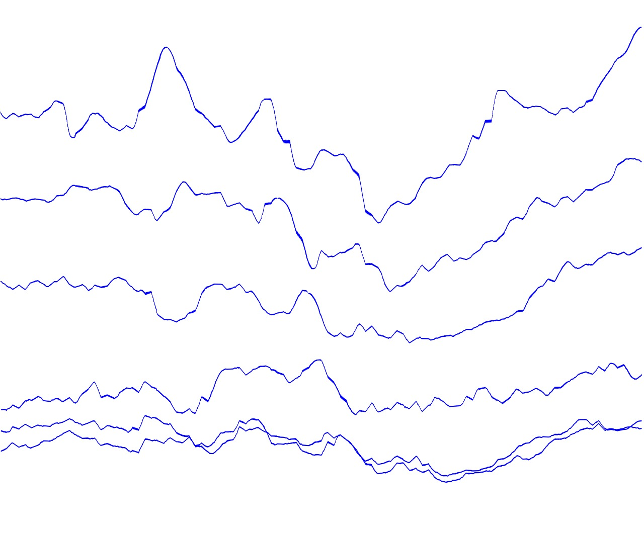
DATASET LINK:
https://www.kaggle.com/datasets/jafarsleman/auditory-brainstem-response-abr-dataset?resource=download

Slide 28
WORK SPLIT-UP
REVIEW 2:
Yuvashri V – Peak detection method 1,preprocessing
Harihara Alagappan R –Peak detection method 2,content writing
Partha Sarathy K – Peak detection method 2,content writing

Slide 29
Problem Identification and Paper Analysis
Review 0
Implementation Up to Conversion of waves images into independent wave
Review 1
Complete Implementation and Result comparison.
Review 2

Slide 30
WORK PLAN
Review Period | Work Particulars | % of Work Completed
Zeroth Review | Base paper Confirmation Problem identification Analysis | -
First Review | Acquisition of wave images Segmentation Conversion of wave images to independent wave | 40%
Second Review | Calculation of peaks Statistical analysis Result comparison | 100%

Slide 31
REFERENCES
[1] J.W. Hall, New Handbook of Auditory Evoked Responses, Pearson, 2007.
[2] D.L. Jewett, J.S. Williston, Auditory-evoked far fields averaged from the scalp of humans, Brain 94 (4) (1971) 681–696.
[3] A. Salamy, Maturation of the auditory brainstem response from birth through early childhood, J. Clin. Neurophysiol.: Off. Publ. Am. Electroencephalograph. Soc. 1 (3) (1984) 293–329.
[4] A. Starr, L.J. Achor, Auditory brain stem responses in neurological disease, Arch. Neurol. 32 (11) (1975) 761–768.
[5] Chiappa KH. Short-latency somatosensory evoked potentials: interpretation. Evoked Potentials Clin. Med. (1990).
[6] W. Ren, F. Ji, J. Zeng, H. Zhao, Intra-operative hearing monitoring methods in middle ear surgeries, J. Otol. 11 (4) (2016) 178–184.
[7] M.P. Gorga, J.R. Kaminski, K.A. Beauchaine, W. Jesteadt, Auditory brainstem responses to tone bursts in normally hearing subjects, J. Speech Lang. Hear. Res. 31 (1) (1988) 87–97. [8] D. Hayes, J. Jerger, Auditory brainstem response (ABR) to tone-pips: Results in normal and hearing-impaired subjects, Scand. Audiol. 11 (3) (1982) 133–142.
[9] R.F. Burkard, J.J. Eggermont, M. Don, Auditory Evoked Potentials: Basic Principles and Clinical Application, Lippincott Williams & Wilkins, 2007.
[10] R.A. Levine, J.C. Gardner, B.C. Fullerton, S.M. Stufflebeam, E.W. Carlisle, M. Furst, B.R. Rosen, N.Y.S. Kiang, Effects of multiple sclerosis brainstem lesions on sound lateralization and brainstem auditory evoked potentials, Hear. Res. 68 (1) (1993) 73–88.

Slide 32
REFERENCES
[11] D.A. Ness, Normative data for neurodiagnostic auditory brainstem response testing (ABR), Louisiana Tech University, 2009.
[12] Z. Meng, M. Wang, J. Bai, M. Xu, H. Mao, H. Hu (Eds.), Interpreting deep learningbased networking systems, in: Proceedings of the Annual Conference of the ACM Special Interest Group on Data Communication on the Applications, Technologies, Architectures, and Protocols for Computer Communication, 2020.
[13] H. Wimalarathna, S. Ankmnal-Veeranna, C. Allan, S.K. Agrawal, P. Allen, J. Samarabandu, H.M. Ladak, Comparison of machine learning models to classify Auditory Brainstem Responses recorded from children with Auditory Processing Disorder, Comput. Methods Programs Biomed. 200 (2021) 105942.
[14] M. Zaitoun, S. Cumming, A. Purcell, K. O’brien, Inter and intra-reader variability in the threshold estimation of auditory brainstem response (ABR) results, Hearing, Balance Commun. 14 (1) (2016) 59–63.
[15] K. Krumbholz, A.J. Hardy, J. de Boer, Automated extraction of auditory brainstem response latencies and amplitudes by means of non-linear curve registration, Comput. Methods Programs Biomed. 196 (2020) 105595.
[16] M. Martinez, J.T. Valderrama, I.M. Alvarez, A. de la Torre, J.L. Vargas, Auditory brainstem responses obtained with randomised stimulation level, Int. J. Audiol. 62 (4) (2023) 368–375.
[17] C. Meyer, M. Waite, J. Atkins, K. Ekberg, N. Scarinci, C. Barr, R. Cowan, L. Hickson, How can ehealth meet the hearing and communication needs of adults with hearing impairment and their significant others? A group concept mapping study, Ear Hear. 43 (2) (2022) 335–346. [

Slide 33
REFERENCES
18] L.M. Van Leeuwen, M. Pronk, P. Merkus, S.T. Goverts, C.B. Terwee, S.E. Kramer, Operationalization of the Brief ICF core set for hearing loss: an ICF-Based e-intake tool in clinical otology and audiology practice, Ear Hear. 41 (6) (2020) 1533.
[19] S. Jeevakala, C. Sreelakshmi, K. Ram, R. Rangasami, M. Sivaprakasam, Artificial intelligence in detection and segmentation of internal auditory canal and its nerves using deep learning techniques, Int. J. Comput. Assist. Radiol. Surg. 15 (11) (2020) 1859–1867.
[20] H. Park, S.N. Hong, H.S. Kim, J.J. Han, J. Chung, M.-W. Seo, S.-H. Oh, S.-O. Chang, J.H. Lee, Determinants of conductive hearing loss in tympanic membrane perforation, Clin. Exp. Otorhinolaryngol. 8 (2) (2015) 92.
[21] N. Sardesai, R. Sardesai, C.-I., Chang (Eds.),. Measurement of hearing loss due to perforated tympanic membrane using image processing techniques. Smart Biomedical and Physiological Sensor Technology XI, 2014. SPIE.
[22] T. Horn, Image processing of speech with auditory magnitude spectrograms, Acustica 84 (1) (1998) 175–177.
[23] B. Kanisha, V. Mahalakshmi, M. Baskar, K. Vijaya, P. Kalyanasundaram, Smart communication using tri-spectral sign recognition for hearing-impaired people, J. Supercomput. 78 (2) (2022) 2651–2664.
[24] S.K. Jameel, R.R. Manza, Color image segmentation using wavelet, Int J Appl Inform Syst(IJAIS) 1 (6) (2012) 1–4.

Slide 34
THANK YOU

